Slide 1
CSE687 - Object Oriented Design
Standard Template Library
Jim Fawcett
Spring 2009
Standard Template Library

Slide 2
Some Definitions
vector, string, deque, and list are standard sequence containers.
set, multiset, map, and multimap are standard associative containers.
Iterators:
  Input iterators are read only – each iterated element may be read only once.
  Output iterators are write-only – each iterated element may be written only once.
  Forward iterators can read or write an element repeatedly. They don’t support operator--() so they can only move forward.
  Bidirectional iterators are like forward iterators except that they support moving in both directions with operator++() and operator--().
  Random access iterators are bidirectional iterators that add the capability to do iterator arithmetic – that is they support *(it + n);
Any class that overloads the function call operator - operator() - is a functor class, and we refer to its instances as functors or function objects.
Standard Template Library

Slide 3
Computational Complexity
Constant time refers to operations that do not depend on the number of elements stored in a container.
  Inserting an element into a list is a constant time operation. Finding the location at which to insert is a linear time operation.
Logarithmic time refers to operations that need time to run that grows as the logarithm of the number of elements in the container.
  A logarithmic operation on a container with 1,000,000 takes 3 times as long to complete as that operation of a container with 1,000 elements.
Linear time refers to operations that require computation time that grows proportionally to the number of elements in the container.
Standard Template Library

Slide 4
STL Supports Guaranteed Complexity for Container Operations
Vectors and Deques:
  Insertion is a linear time operation.
  Accessing a known location is constant time.
  Searching an unsorted vector or deque is a linear time operation.
  Searching a sorted vector or deque should be a logarithmic time operation ( use binary_search algorithm to ensure that it is).
Lists:
  Insertion is a constant time operation.
  Accessing a known location and searching, whether sorted or not, is linear time, with the exception of the end points, which can be accessed in constant time.
Sets and Maps:
  Insertion and accessing are logarithmic time operations.
  Searching should be a logarithmic time operation (use member function find, etc., to ensure that it is).
Standard Template Library

Slide 5
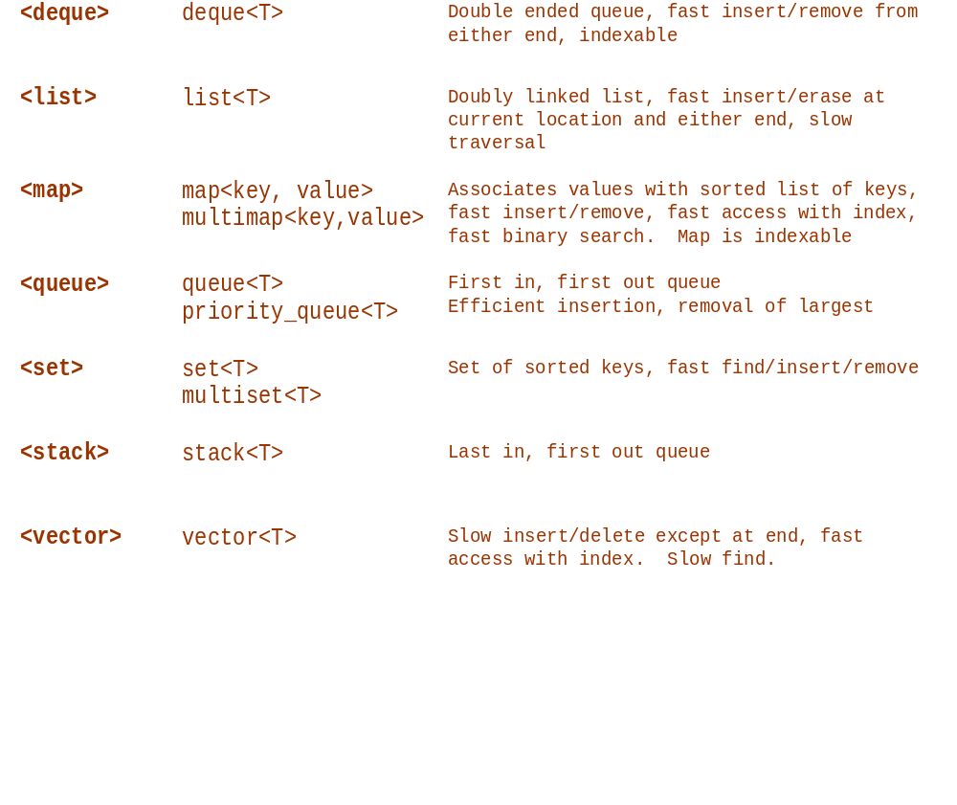
STL Header Files for Containers
Standard Template Library

Slide 6
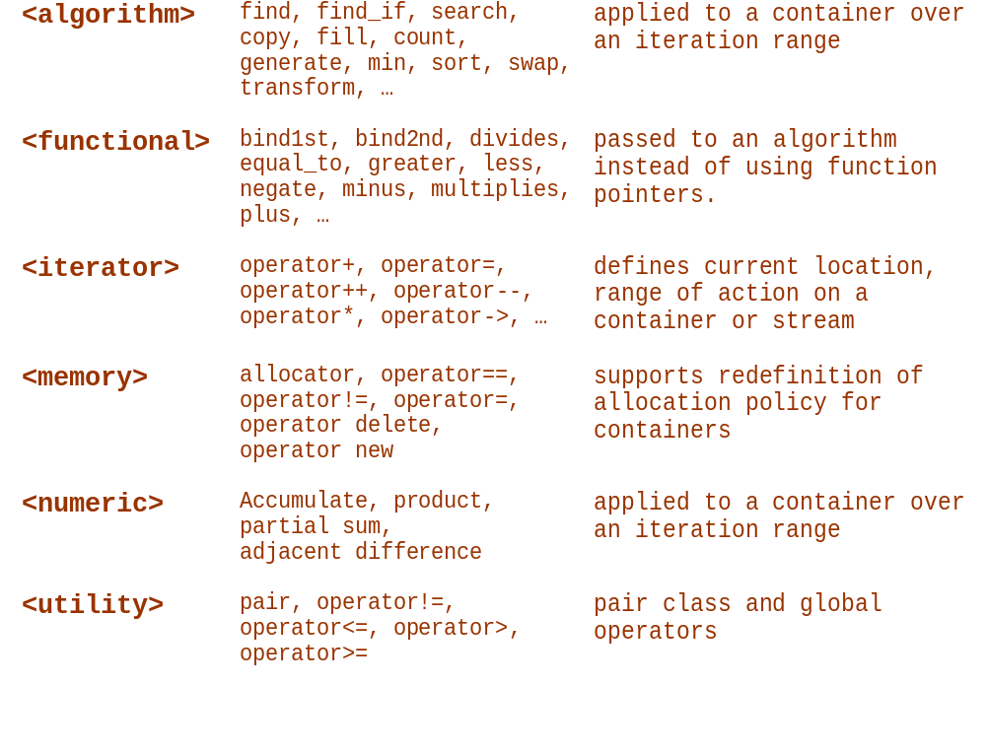
Other STL Header Files
Standard Template Library

Slide 7
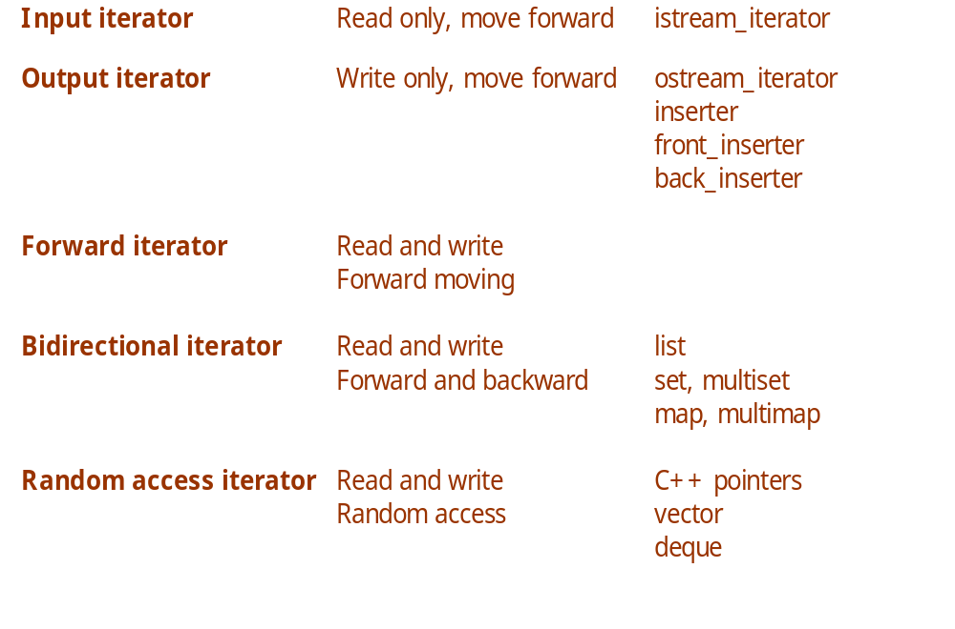
STL Iterators
Standard Template Library

Slide 8
STL Functions
unary functions:
  take single argument of the container’s value_type
  // unary function
  template <typename T>
  void printElem(T val) {
  cout << “value is: “ << val << endl;
  }
  void main( ) {
  list< int > li;
  :
  // unary function used in algorithm
  for_each(li.begin(), li.end(), printElem);
  }
Standard Template Library

Slide 9
STL Functions
predicate:
  function taking a template type and returning bool
  // predicate
  template <class T>
  bool ispositive(T val) { return (val > 0); }
  void main( ) {
  list<int> li;
  :
  // return location of first positive value
  list<int>::iterator iterFound =
  find_if(li.begin(), li.end(), ispositive<int>);
  }
Standard Template Library

Slide 10
STL Function Objects
Function objects:
  class with constructor and single member operator()
  template <class T> class myFunc {
  public:
  myFunc( /*arguments save needed state info */) { }
  T operator()(/* args for func obj */) {
  /*
  call some useful function with saved
  state info and args as its parameters
  */
  }
  private:
  /* state info here */
  }
Standard Template Library

Slide 11
unary_function type
The unary_function type serves as a base class for functors that will be used in adapters like not1. It supplies traits needed by the adaptors.
An example use follows on the next slide
#include <functional>
template <class Arg, class Result>
struct unary_function{
typedef Arg argument_type;
typedef Result result_type;
};
Standard Template Library

Slide 12
STL Function Adapters
negators:
  not1 takes unary_function predicate and negates it
  not2 takes binary_function predicate and negates it
  // predicate
  template <class T>
  class positive : public unary_function
  {
  public:
  bool operator()(T val) const { return (val > 0); }
  };
  void main( ) {
  list<int> li;
  :
  // return location of first positive value
  list<int>::iterator iter =
  find_if(li.begin(), li.end(), positive);
  // return location of first non-positive value
  iter = find_if(li.begin(), li.end(), not1(positive));
  }
Standard Template Library

Slide 13
binary_function type
The binary_function type provides traits needed by binary function adapters, as illustrated on the next slide.
#include <functional>
template <class Arg1, class Arg2, class Result>
struct binary_function
{
typedef Arg1 first_argument_type;
typedef Arg2 second_argument_type;
typedef Result result_type;
};
Standard Template Library

Slide 14
STL Function Adapters
binders:
  bind1 binds value to first argument of a binary_function
  bind2 binds value to second argument of binary_function
void main( ) {
list<int> li;
:
// return location of first value greater than 5
list<int>::iterator =
find_if(li.begin(), li.end(), bind2(greater<int>(),5));
}
Standard Template Library

Slide 15
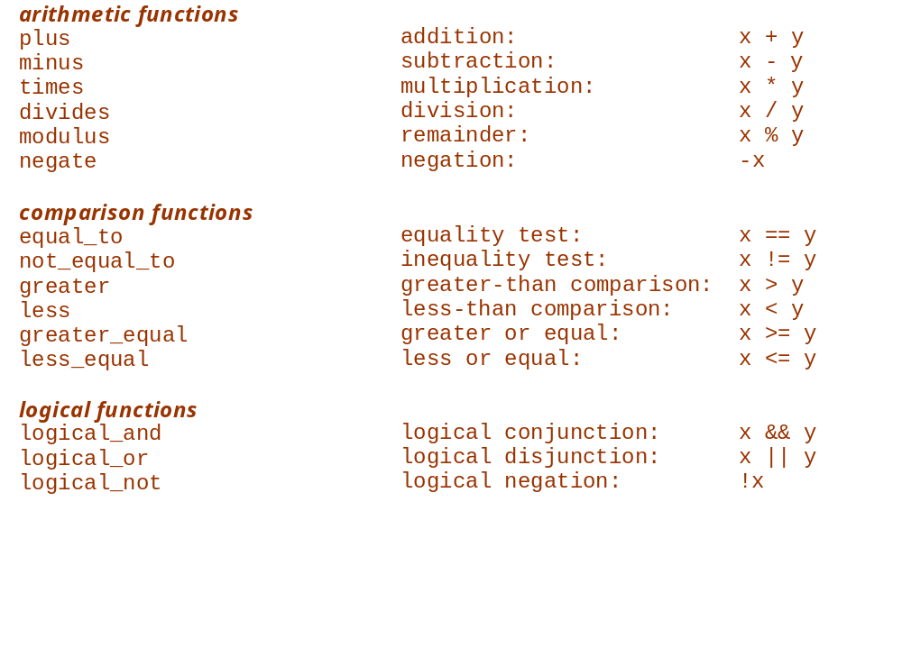
STL Function Objects
Standard Template Library

Slide 16
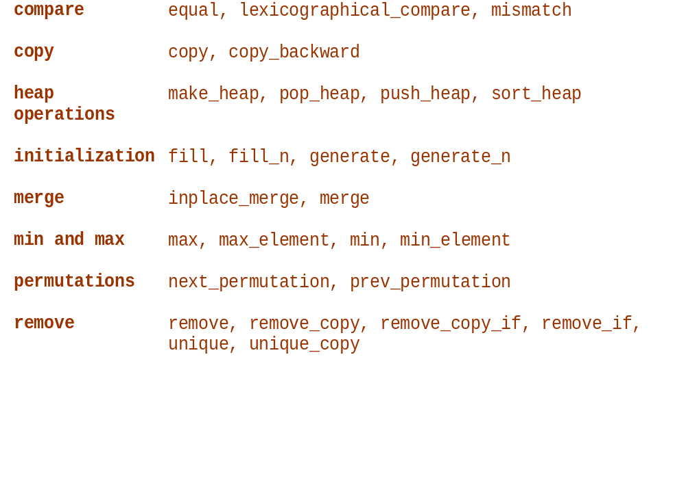
Algorithms by Type
Standard Template Library

Slide 17
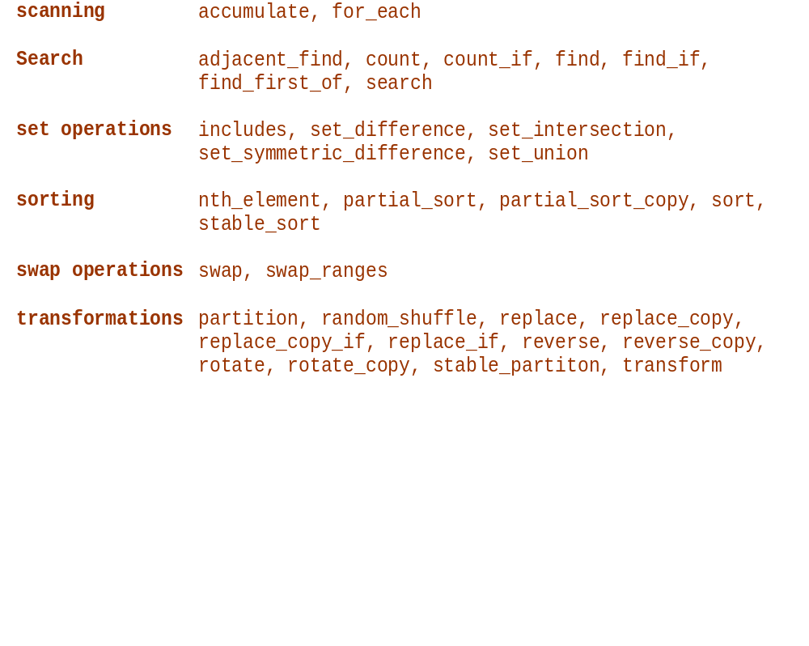
Algorithms by Type (continued)
Standard Template Library

Slide 18
End of Presentation
Standard Template Library

